Slide 1
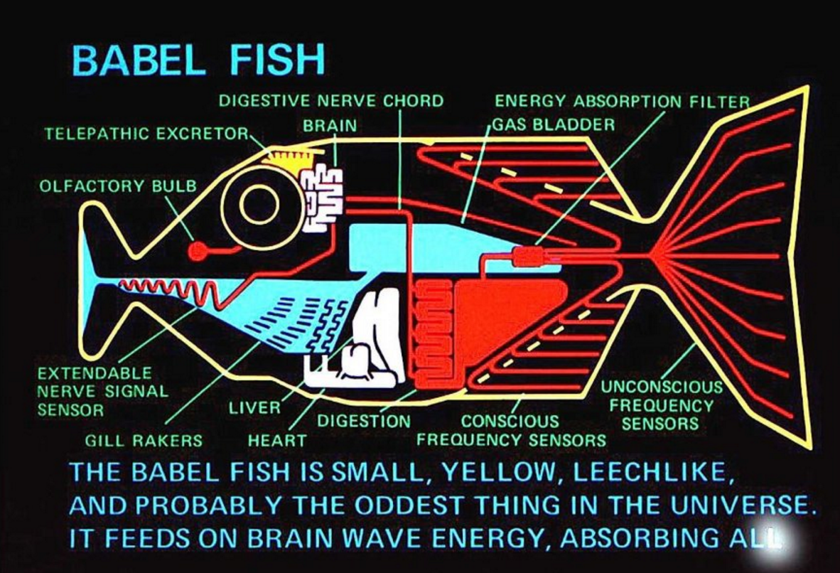
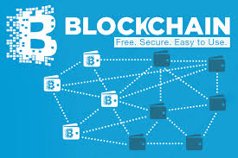
IoT Babelchain - Proof of Understanding
How Machines learn to communicate
Benedikt Herudek (benedikt.herudek@gmail.com)
April2016
Linux Foundation
Open IoT

Slide 2
Abstract
Imagine we could extend and generalize the bitcoin model into a digital information and message exchange framework allowing parties in a distributed network to exchange information with a consensus on dataexchange formats. This approach wants to investigate how this could be done in a bitcoin way. A.o. adjustments we would suggest replacing the hashing work miners do with machine learning algorithms so called translators would do.
This presentation suggests to solve this Problem (in IoT often referred to as the ‘Baskets of Remotes’ Problem) by following the Consensus Approach Bitcoin and Blockchain Technologies take:
Participants in a distributed Network can ’translate’ messages from one to another protocol with the help of Machine Learning Algorithms
Successful Translators will receive awards in a cryptocurrency like Miners in a Bitcoin Network get rewards for Executing Proof of Work
(partially) replace a Bitcoin Proof of Work by a proposed Consensus Mechanism Proof of Understanding
The resulting System will:
translate Messages from different protocols into each other
arrange immutable translated Transactions into a Blockchain
This ‘Thought Experiment’ is to be understood as a proposal to implement a prototype for a new kind of Integration Layer. One of several open question is if we the resulting Blockchain will have the same level immutability feature as the Bitcoin Blockchain
Notes:
This talk is about Machine Communication. Technically, we will follow a ‘Bitcoin Blockchain Flavor’ approach, add some ingredients from Machine Learning and suggest a novel approach how to build an Integration Layer.

Slide 3
Agenda
check
Introduction
The Problem: Disparate Machine Protocols can’t communciate with out translation
Bitcoin versus ‘classical’ Integration Approach
Understanding
Format Handshake
Content Handshake
Action Handshake
Translator Machine Learning (as equivalent to Mining Hash Power in Bitcoin)
pickcing common data exchange formats
Generating common data exchange formats
Mapping different data exchange formats
Immutability
Overview
Pre-req for Bitcoin Proof of Work
Replacing Proof of Work
Summary
Comparing Bitcoin Blockchain and Proof of Understanding Blockchain (‘Babelchain’)
Once again: What we claim & Why it all matters …

Slide 4
Introduction
Insert short description (the problem, why it is a ‘Blockchain’ problem also
check

Slide 5
Machines can’t (hardly) communicate !
The Enterprise Integration Version
check
The IoT Version
Consider the case of a CRM and Billing System and a Provisioning System in a Telecommunications enterprise.
Client order are taken in with the CRM Sy
stem, the order is send to the Provisioning System, The Billing System will be responsible to generate a bill to the
All three Systems (in fact there are many more) know the concept of a Client and of Products, but they have different ways of talking about them and their internal Data Models differ.
Devices have different message Formats but need to be able to communicate, e.g. The iPhone needs to be able to take over from all remote controls and talk to the Samsung TV
Devices can get connected via Software Solution in a centralized or distributed Cloud Solution
Problem is increasing with number of devices and exposure to the end users who will not like large enterprises be able to account for the Integration effort between disparate protocols
The ‘Broken Trusted Middle Man’ Solution
Suggest an Industry Standard or follow a Standard set by a large player
But:
Large players dont stick to industry standards
With the number of usecases, applications and devices, innovations and the globalized character of the internet industry standards are impossible to keep up
The gated community version
The Blockchain ( to be !) version
Facebook / Apple closing networks
They deliver a service … one language to allow them all to communciate
What data Standard will the Blockchain expect and how can connected end points communicate ?
Will there be different standard for different Blockchains ?
Any Transaction System has to solve the question of a common data format either by enforcing (Bitcoin and e.g. most Integrations patterns like SOA and alikes) or negotiating (Babelchain)
Notes:
The Problem of Machine Communication is well known before and independently of Internet of Things. Machines and Applications need to exchange Information about similar things (like Products and Clients) , but they do that in different languages. Take a Billing and a CRM Sytem, they both know the Client and the Products sold, but they need a rather complex Integration Layer to talk to each other.
Why is the problem particularly ‘burning’ for IoT :Because we have so much more devices and ‘players’ in the net all with their own languages! Additionally, a large part is consumer facing and consumer are neither ready nor willing to ‘integrate’ applications, which in a Business Context we do with expensive software like Enterprise Service Buses and expensive staff.

Slide 6
The ‘naïve’ way of copying Bitcoins Approach to integrate Endpoints
Bitcoin is able to integrate endpoints (wallets, miners) in a large distrubuted network seemlessly without any integration effort
Wallet
Wallet
Blockchain:
Transactions (Blockchain) are permanent & primary
Enpoints (Wallets) are derived & ephemeral
Blockchain
Application
Application
Conventional Systems
Transactions (EBS) are derived & ephemeral
Enpoints (Applications) are permanent & primary
Integration
Layer
Following Bitcoin would mean to create a standard for handling transactions
Even though Existing Systems often do not keep Transactions but the end points permanent, they use a similar approach
existing SOA Style (Microservices, API Industry) follow the same pattern in dictating a message exchange format.
often, these are Industry, Technollgy Vendor or Enterprise Standards
Notes:
Bitcoin achieves something susprising: In a way it solves all Integration Problems. If You open a wallet on your phone, you can talk within minutes to the whole network. In a business Context plugging in an application to a network and have it talk with other applications (wallets) can take anything from minutes to years over even fail.
How does Bitcoin do that ? It flips around the notion of Transaction and endpoints. The Transactions (Blockchain) are permanent, the endpoint (wallets) is derived.
However, at the end of the day it still does something similar that current Integration Layers do: it mandates the use of certain data formats, only if you do so can you participate in the network. That is the right approach for a limited (even though very important) like financial transactions. For the abundance of players in the Internet of Things that wouldn’t work.

Slide 7


What can we learn from Bitcoin and Blockchains?
Bitcoin
How can machines securely come to an agreement about the status of transactions without resorting to a trusted third party ?
Internet of Things
How can machines come to an agreement about the meaning of a message without resorting to a trusted third party ?
IoT Server
Proof
of
Understanding
IoT Server
Computing Power
Miner’s Hashing Power
Use the CPU power of a large distributed System
Predictive Machine Learning Capabilities
Incentives
Rewards for Hashing Blockheaders
Cryptocurrency reward chance on fulfilling certain
Rewards for Translating Messages
Consensus
Immutable Transactions
Establish Consensus in a distributed (unmuteable) System
Common Language
Middleman
Banks, Credit Cards
Mediating Instance, that overseas both sides
And permanently stick between parties
Standards (technology, vendor, industry)
Notes:
What can we still learn from Bitcoin ? We can learn how Bitcoin creates Consensus. Bitcoin does that for transactions and their order, The question we should ask is how machines can come to a consenus about how to communicate. We use incentives and we will use ‘Machine work’ to do achieve.
Side remark: why are Blockchains relevant anyways for IoT. You can suspect they will be financially more benefitial: longerlasting, also if vendors went down or dnt support old versions any more etc

Slide 8
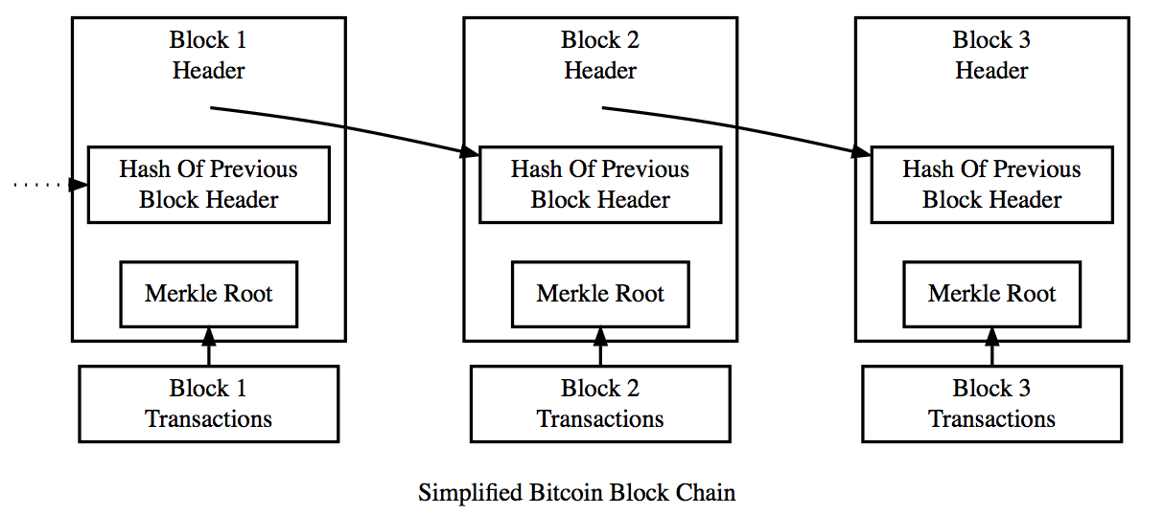
Proof of Work: create a shared & immutable bitcoin transaction ledger
The “previous block hash” field is inside the block header
When the parent is modified in any way (eg fraud), the parent’s hash changes and hence the child hash changes and so on
The cascade effect would require that much computing power that deeper layers are practically immutable
With courtesy from the bitcoin book of
Andreas Antonopoulos
and documentation from bitcoin.org
4.Independent selection, by every node, of the chain with the most cumulative computation demonstrated through proof of work
Mining & Feeds align Miner’s (financial) with Network ( immutable transaction ledger) interest
Mining via ‘ hash puzzles’
process of hashing the block header repeatedly, changing one parameter (‘nonce’) , until the resulting hash matches a specific target
The hash function's result cannot be determined in advance, nor can a pattern be created that will produce a specific hash value
Hence, the only way to produce a hash result matching a specific target is to randomly modifying the input until the desired hash result appears by chance.
1.Independent verification of each transaction, by every full node, based on a comprehensive list of criteria
3.Independent verification of the new blocks by every node and assembly into a chain
2. Independent aggregation of transactions into new blocks by mining nodes, coupled with demonstrated computation through a proof of work algorithm
Notes:
Question: who is familiar with the proof of work and its role in Bitcoin ?
Fascinating & at the heart of Bitcoin, easily good for an entire presentation.
One of the most interesting features is that security ’immutability’ is achieved without restricting access and having only trustable players in the network.
Instead, it uses incentives such that it is benefitial to play honest and very expensive (too expensive) to try to cheat.
2 Aspects that matter for us most:
Miners have to hash a Block of Transactions changing one value in it (the nonce) such that the result is a number below a set difficulty target. That is difficult and requires brute force trying, who wins (it is easy to verify even though difficult to find) wins a mining reward
Blocks are linked such that every block contains a fingerprint of the previous. Hence changing a predecessor causes a cascade effect, which causes so much work to redo if someone tries to rollback, that it is not feasible to achieve.
The consensus we are looking at it is achieved implicitly by miners choosing the longest chain, where most computing power is behind. This gives them the best chances to win
------------------------------------
Example:
For example, if the maximum possible hash value is 2²⁵⁶ − 1, you can prove that you tried up to two combinations by producing a hash value less than 2²⁵⁵.
Hash Algorithm:
A hash algorithm takes an arbitrary-length data input and produces a fixed-length deterministic result, a digital fingerprint of the input. For any specific input, the resulting hash will always be the same and can easily be calculated and verified by anyone implementing the same hash algorithm. The key characteristic of a cryptographic hash algorithm is that it is virtually impossible to find two different inputs that produce the same fingerprint. As a corollary, it is also virtually impossible to select an input in such a way as to produce a desired fingerprint, other than trying random inputs.
Immutability:
The “previous block hash” field is inside the block header and thereby affects the current block’s hash. The child’s own identity changes if the parent’s identity changes. When the parent is modified in any way, the parent’s hash changes.
The parent’s changed hash necessitates a change in the “previous block hash” pointer of the child. This in turn causes the child’s hash to change, which requires a change in the pointer of the grandchild, which in turn changes the grandchild, and so on. This cascade effect ensures that once a block has many generations following it, it cannot be changed without forcing a recalculation of all subsequent blocks. Because such a recalculation would require enormous computation, the existence of a long chain of blocks makes the blockchain’s deep history immutable, which is a key feature of bitcoin’s security.
One way to think about the blockchain is like layers in a geological formation, or glacier core sample. The surface layers might change with the seasons, or even be blown away before they have time to settle. But once you go a few inches deep, geological layers become more and more stable. By the time you look a few hundred feet down, you are looking at a snapshot of the past that has remained undisturbed for millions of years. In the blockchain, the most recent few blocks might be revised if there is a chain recalculation due to a fork. The top six blocks are like a few inches of topsoil. But once you go more deeply into the blockchain, beyond six blocks, blocks are less and less likely to change.

Slide 9
Understanding
Insert Short description (the idea)
check

Slide 10
‘Meaning’ for Machines: Syntax, Semantic, Pragmatics
Meaning is defined as a key value pair of Format & Content potentially triggering an Action:
<ZAP_TV>
<to>
<receiver>TV in my chinese hotel
room</receiver>
<path> TV Cloud Server</path>
</to>
<from>
<sender>my smart phone remote app
</sender>
<path> smart phone Cloud Server</path>
</from>
<body>
<device> TV <device>
<command> change channel
</command>
<channel> 12</value>
</body>
</ ZAP_TV >
Message Format like file with fields, XML messages, csv files, binary files
There are variable slots in which values with Content will go
Action in the real world or a digital form (photo, fingerprint of a machine state)
It can be verified by humans or advanced machine algorithms
Examples:
(Digital fingerprint of) changed state in TV
(picture of) Temperature measuring room on 20 degree
<body>
<device> …<device>
<command> …
</command>
<channel> .</value>
</body>
TV
change
channel
12
Sender
communicate
Receiver
verify
offer
offer
reward
Translator
Notes:
‘Meaning’ Communication consists of three parts, where each depends on each predeessor. Syntax, Semantics, Pragmatics.
Idea is: in Bitcoin the Miner does the work of securing the Blockchain via hashing blocks against difficulty targets. In what I call Babelchain, the Translator does the work of proposing message formats to Sender & Receiver until they can agree to one and start communicating

Slide 11

Format Handshake
There is an assumption here a Translator can make format suggestions ! Hang on a couple of slides !
1. A sender creates a message with content (key value pairs in potentially a hierarchical structure) and sends it to the Receiver … <device> TV<device> <command> change channel </command> <channel> 12</value> …
4. Sender & Receiver pick one message formats they ‘believe’ they would be able to understand.
Repeat Format Handshake
Sender
Failure
3. Translators offer different data formats and offer those to sender and receiver … <thing> …<thing> <action > … </action> <what_action> …</what_action> …
5. The Translator that generated the format that is first picked by both sender and receiver is marked for the the part of the reward for the format translation.
Format
Hand-
shake
Proof of Understanding
Agreed
Format
mandatory
2. Unless the Receiver (‘believes to’) understand the message, the message gets offered to the Babelchain Translators with a bounty … <device> TV<device> <command> change channel </command> <channel> 12</value> …
4. Sender & Receiver pick one message formats they ‘believe’ they would be able to understand.
Success
Receiver
Action Handshake

Slide 12
Content Handshake
See this as a confirmation that
the agreed message format is
understood by both in the same way
Repeat Format Handshake
3. The Sender will have to agree to the solution, if he doesn’t another message format has to be found and the format handshake round of the quiz will have to start
4. If Sender and Receiver agree on the correct assignment, then whoever of the Translators offered the correct solution will get marked for the Content part of the reward..
Sender:
Failure
5. If no Action Handshake is mandated both sign the hashed messaged header rewards will get paid out … <thing> TV<thing> <action > change channel </action> <what_action> 12</what_action> …
1. Translators will compile all possible combinations of value assignments to the format. … <thing> TV<thing> <action > change channel </action> <what_action> 12</what_action> …
Content
Hand-
shake
Proof of Understanding
Agreed
Content
for
Format
mandatory
Receiver:
2. The Receiver will pick the combination, that ‘works for him’
4. If Sender and Receiver agree on the correct assignment, then whoever of the Translators offered the correct solution will get marked for the Content part of the reward..
Success
Transaction / Action Handshake (optionally)

Slide 13
Action Handshake
See this is a test, that there really was
no misunderstanding during
format & content handshake
Humans could do it, if simple and we good, we automate it
Repeat Format / Content Handshake
Sender:
2. Receiver upon his or Senders initiative has to offer evidence of the action. Digital picture of a If the handshake is confirmed
Failure
1.Sender or Receiver can choose to open this round before continuing.
Agreed Action
on
Content
for
Format
Action
Hand-
shake
Proof of Understanding
3.Evidence will be checked by machines or humans, upon success: both sign the hashed messaged header, rewards will get paid out
mandatory
Receiver
Actions handshake can reconfirm the format & Content Handshake but can be time-consuming (if humans check) or difficult for machines to undertake.
It can typically be useful 1st time two systems handshake and messages can trigger significant and sensitive actions, like opening a banksafe or launching a rocket
Choosing for this handshake wil depend on probability to fail (determined by sender or receiver) and the risk implied upon a misunderstanding
Success
Transaction

Slide 14
Translators
Insert short description (the problem, why it is a ‘Blockchain’ problem also
check

Slide 15
Translators I – Picking MessagesMessages
A ‘common sense’ approach to building a Translator would be as follows:
Build a list of
common Internet, Enterprise and other message exchange formats
Categorize them along Vendor, Technology Platform, Industry, use-case a.o.
Ensure that Sender & Receiver exchange any information that could be relevant for finding a common message:
Which parts of the message are variable (content) and which are fixed (format)
Categories like Industry, used Technology Vendor they fall under as listed in (2)
Relevant contextual Information, e.g. smart phone owner trying to change temperature is located in a hot country with current temperature x amount Fahrenheit and so on
Ensure the Translator has a message parsing mechanism, a.o. allowing to:
differentiate format from content
categorize format along the categories described in (1b)
Ensure the Translator has message creation mechanism, a.o. allowing to
Accept information shared by sender and receiver (2) as input
pick a message from common message exchange patterns from table (1a) with the help of the categories listed in (1b)
adjust these messages where necessary with module (3)
Ensure the Translator has a content distribution mechanism, allowing to take all values from the message initially shared by sender and placing them in all possible combinations in the value slots provided in the message format suggested by the sender
Ensure the Translator keeps a log of all handshakes and
updates the logs after each (un-) successful handshake with as much information as possible
for any new handshakes reads the log and tries to deduct in a smart way what handshakes could work this time
Notes:
Common sense: Guess you find two vendors, e.g. SAP, or a Technology say Java. Then you know their industry, then you see the message the sender wants to send, you can probably pick some xml standard, SAP standard or Industry Standard.

Slide 16
Translators II – Generating Messages
The Babelchain Data structure will be designed such that it offers a training set of success- and unsuccessful handshakes with all relevant features.
Over such a training set Translators can create a supervised logical or probabilistic regression learning algorithm trying to predict message formats, contents. Statistical Machine Learning Algorithms can Machine learning algorithms (eg swiftspear)can create shakespeare sonnets when fed with existing one’s
Participants typically would feed their Translators with all kinds of xml, csv and other technology and industry message exchange standards
There would need to be a proper balance between what is made public on the blockchain to allow the network to learn and what successful Translators keep private for themselves. ‘Public’ data on the blockchain serving as training data would be masked and or permissioned
Translating will get easier over time with the network and translators learning, hence Translators will need to receive other rewards eg for infrastructure services like delivering messages within time, similar to the bitcoin shift from miners benefiting from Mining rewards towards transaction fees
Message | Location Start Signal | Identity Sender | Identity Receiver | Feature n | S ACK Format | R ACK Format | S ACK Content | R ACK Content | S ACK Action | R ACK Action | Format Handshake | Content Handshake | Action Handshake
… <device> TV<device> <command> change channel </command> <channel> 12</value> … | Hotel, front of TV | GUEST | TV Hotel | … | yes | yes | yes | yes | yes | yes | <<device>>; <<command>>;<<value_command>> | TELEVISION; ADJUST_CHANNEL;12 | -
… <device> Themostat<device> <command> adjust temparaturechannel </command> <channel> 20</value> … | Hotel, front of thermostat | GUEST | Thermostat Hotel | … | yes | no | - | - | - | - | THERMOSTAT; ADJUST_CHANNEL;12
… safe; OPEN … | Hotel, front of sage | UNKNOWN | Safe Hotel | … | ? | ? |  |  |  |  | ?
checked
Notes:
More sophisticated: Machine Learning, e.g. we have Algorithms that can write poems based on an authors style. Surely such mechanisms can write Message Formats and Conversation, if we give them a supervised training set.
http://natematias.com/portfolio/DesignArt/Swift-SpeareStatisticalP.html
http://natematias.com/portfolio/Business/DrJohnsonARapidPrototypi.html

Slide 17
Translators III – MappingMessages
In case we cant find one message format with both approaches, we need to pick two message formats generated and map, the translator will do that
ABC
describe

Slide 18
Immutability
Insert short description ( the idea)
check

Slide 19
Immutable Proof of Understanding
 | Description | Energy Waste | Goods & Bads
Smart Contract | write out a competition, a bounty smart contract where anyone solving the translation task will get a cryptocurrency award like ethereum paid out | High: as high as the hosting blockchain e.g. ethereum No smart reuse of the work translators do | + Ideal for prototyping - Low scalability
Prereq for Proof of Work | whoever generated a valid proof of understanding (there can be several) can start the proof of work Hashing puzzle and finding a nonce will include the agreed message, hence proof of work can be started only after proof of understanding Agreed Message will be signed by sender and receiver, so anyone in the network can check | Smarter, not lower: Machine work will be used for a useful task Combined work overall would be similar to bitcoin blockchain | + Re-use proven Bitcoin approach to make the Blockchain immuteable + high scalability - Energy consumption and waste as high as Bitcoin - To be clarified, how the effort of proof of understanding can be measured and how proof of work difficulty target could be adjusted dynamically
Replace Proof of Work | In any transaction system between connected parties having a common terminology is a pre req to make useful transactions. With the size and amounts of usecases in IoT the ‘one agreed transactio data format’ strategy of Bitcoin will not be feasible. | Smarter and lower: Machine work will be used for a useful task Effort for Translation will decrease with the learning effect | + high scalability + use of machine work to cover 2 goals: translation & immutability To be clarified how Blockchain Immutability will be achieved, even more with learning effect and decreased work Potentially smart combination of machine work with consent sender & receiver to message reverts
Notes:
How do we implement it ? I know of three and the last one would be most desireable.
It is desireable that we replace the proof of understanding as much as possible, because it is in some sense ‘useless’ work. It does faciliate and immutability but we would like to create that while doing something useful.
Also, Bitcoins demands on security without restricting access are rather extreme. There is no identity and access management and all is on consensus, one could argue there are non – financial usecases which have less or different demands on security.

Slide 20


Proof of Understanding as prereq for existing Proof of X Mechanims
understanding
immutability
Bob
Proof of Work
Proof of Understanding
Alice
prereqt
mandatory
Proof of Stake
Combine with ‘Proof of Work’ style:
have Translator not only find Translations but also hash them against a difficult target
Proof of Understanding Message will be signed by sender and receiver
Only who generated a valid proof of understanding can start the proof of work,
fingerprint of the agreed message is part of the blockheader for which to find a nonce to meet the difficulty target
Revising a handshake will require re-do of computationally expensive Hash – against – difficulty - targets like in bitcoin
Combine with Reputation, Trustability and ‘Proof of Stake’ Systems:
Have not only sender and receiver agree to handshakes but have also other ‘trustable’ network members like eg very successful Translators sign and approve translations
Trustability or Reputation is defined via the amount of currency won as it indicates that a member is very knowledgeable about correct Translations
Members additionally holding a large amount of the cryptocurrency hold a financial stake in the network and have interest to avoid fraud
Notes:
Idea is: you can only start with proof of understanding after sender & receiver signed and thereby agreed to the transation.
If we can measure the proof of understanding reliably and we can adjust the proof of understanding, we replaced part of the work with useful work.
There are open questions, what exactly would happen when someone tries rolling back. One would need to ask consent and then redo proof of work against a difficulty target

Slide 21
Proof of Understanding – Signing Immutability
same receiver
Transaction 1 Header
Transaction 1 Header
Transaction 1 Header
Signature hashed header Sender
Signature hashed header Sender
Signature hashed header Sender
Signature hashed header Receiver
same sender
Signature hashed header Receiver
Signature hashed header Receiver
Large Finger Print:
Hash Of All Transaction Handshakes older than own Transaction
To do: looks abit like proof of stake
(signing not mining),
So we have
nothing at stake and long range attack?
Large Finger Print:
Hash Of All Transaction Handshakes older than own Transaction
Large Finger Print:
Hash Of All Transaction Handshakes older than own Transaction
Small Fingerprint:
Hash Of Own Transaction Handshakes
Small Fingerprint:
Hash Of Own Transaction Handshakes
Small Fingerprint:
Hash Of Own Transaction Handshakes
Initial Message
translated Message
Handshake History and relevant Features for specific Transaction
Initial Message
translated Message
Handshake History and relevant Features for specific Transaction
Initial Message
translated Message
Handshake History and relevant Features for specific Transaction
Cascade Effect :
A Blockchain representing ‘Conversations’ between Senders & Receivers would take:
small fingerprint: hash fingerprints of their own Handshake Negotiations
large fingerprint: Handshake Negotiation history existing at the time of their handshake
Changing a transaction, handshake will trigger:
weak immutability:
Re-do translation work, unless same format / content / action accepted
Re-ask consent from senders and receivers if handshakes are adjusted
Header needs to get hashed, optionally against a difficulty target
strong immutability: Change of Handshake will change the Large Fingerprint of all younger Transactions
Re-do all translation work, unless same format / content / action accepted
all those Senders Receivers will need to sign the Header again
All their Headers need to get hashed, optionally against a difficulty target
same topic
Remarks:
Usage of a hash against a difficulty target can be necessary to rule out the possibility that (all affected) sender & (all affected) senders conspire to revert transactions on expense of a 3rd party affected in the real world but not part of the digital transaction
The larger the network, the less likely it is all will ’cheat’. Usage of a hash against a difficulty target can therefore be useful especially in the network startup phase when the network is small and the cascade effect hence neglectable
Note neither Blocks of Transactions nor Transactions (C pays B) depend on previous Transactions (B pays A)
There is an indirect link via the history of handshakes (the training set), which can be used to create a cascade effect (see below)
Transactions in a Blockchain representing Conversations between Machines are loosely coupled along Senders & Receivers or topics (training set features) like in a social network
Notes:
Main question here: how can we re-create the cascade effect that makes reverting the Bitcoin Blockchain infeasible with Hashing puzzles for the Proof of Understanding Machine Learning Mechanism ?
The Idea: You take the training set, the underlying succesful and unsuccesful handshakes as the thing that links the handshakes because the training set helped to predict the messages.
You link this by placing hash fingerprints of both the handshakes for the specific transaction and the entire training set in the Transaction Header
Redoing ones own transaction: Either one the sender or receiver has to ask the other one to agree, otherwise it wont happen. But sender and receiver could conspire on exepense of a 3rd party that was not in the transaction.
Cascade: : all transactions will get effected, that used the transaction which was there in the first place when checking the fingerprint. Therefore you need to ask all these senders and receivers to agree
This will work pretty well if the network os large with many participants, one will most likely say no. maybe someone who might get affected negatively
In the beginning of the network, yoy could combine this with proof of work and cascading changes.
Note we don’t linkt transactions like in the Bitcoin, Rather you will have transactions connected via the training set and then rather loosely like in a social network like with sender receiver topics (features) and alike

Slide 22
Proof of Understanding – Working Immutability
same receiver
Transaction 1 Header
Transaction 1 Header
Transaction 1 Header
Signature hashed header Sender
Signature hashed header Sender
Signature hashed header Sender
Signature hashed header Receiver
same sender
Signature hashed header Receiver
Signature hashed header Receiver
Large Finger Print:
Hash Of All Transaction Handshakes older than own Transaction
Large Finger Print:
Hash Of All Transaction Handshakes older than own Transaction
To do
We prefer
A proof via work you did!!!
Not just signing !
Large Finger Print:
Hash Of All Transaction Handshakes older than own Transaction
Small Fingerprint:
Hash Of Own Transaction Handshakes
Small Fingerprint:
Hash Of Own Transaction Handshakes
Small Fingerprint:
Hash Of Own Transaction Handshakes
Initial Message
translated Message
Handshake History and relevant Features for specific Transaction
Initial Message
translated Message
Handshake History and relevant Features for specific Transaction
Initial Message
translated Message
Handshake History and relevant Features for specific Transaction
What about this, when reverting:
- You have to re-play the handshake history with sender & receiver
such that you achieve the same (lower ?) target than before BUT you must add the
nonce with the value of the previous transaction header
Note that you play with the machine learning algorithm, not the hash
First time (not redoing) this mechanism means:
Cascade Effect :
A Blockchain representing ‘Conversations’ between Senders & Receivers would take:
small fingerprint: hash fingerprints of their own Handshake Negotiations
large fingerprint: Handshake Negotiation history existing at the time of their handshake
Changing a transaction, handshake will trigger:
weak immutability:
Re-do translation work, unless same format / content / action accepted
Re-ask consent from senders and receivers if handshakes are adjusted
Header needs to get hashed, optionally against a difficulty target
strong immutability: Change of Handshake will change the Large Fingerprint of all younger Transactions
Re-do all translation work, unless same format / content / action accepted
all those Senders Receivers will need to sign the Header again
All their Headers need to get hashed, optionally against a difficulty target
same topic
Remarks:
Usage of a hash against a difficulty target can be necessary to rule out the possibility that (all affected) sender & (all affected) senders conspire to revert transactions on expense of a 3rd party affected in the real world but not part of the digital transaction
The larger the network, the less likely it is all will ’cheat’. Usage of a hash against a difficulty target can therefore be useful especially in the network startup phase when the network is small and the cascade effect hence neglectable
Note neither Blocks of Transactions nor Transactions (C pays B) depend on previous Transactions (B pays A)
There is an indirect link via the history of handshakes (the training set), which can be used to create a cascade effect (see below)
Transactions in a Blockchain representing Conversations between Machines are loosely coupled along Senders & Receivers or topics (training set features) like in a social network
Notes:
Main question here: how can we re-create the cascade effect that makes reverting the Bitcoin Blockchain infeasible with Hashing puzzles for the Proof of Understanding Machine Learning Mechanism ?
The Idea: You take the training set, the underlying succesful and unsuccesful handshakes as the thing that links the handshakes because the training set helped to predict the messages.
You link this by placing hash fingerprints of both the handshakes for the specific transaction and the entire training set in the Transaction Header
Redoing ones own transaction: Either one the sender or receiver has to ask the other one to agree, otherwise it wont happen. But sender and receiver could conspire on exepense of a 3rd party that was not in the transaction.
Cascade: : all transactions will get effected, that used the transaction which was there in the first place when checking the fingerprint. Therefore you need to ask all these senders and receivers to agree
This will work pretty well if the network os large with many participants, one will most likely say no. maybe someone who might get affected negatively
In the beginning of the network, yoy could combine this with proof of work and cascading changes.
Note we don’t linkt transactions like in the Bitcoin, Rather you will have transactions connected via the training set and then rather loosely like in a social network like with sender receiver topics (features) and alike

Slide 23
Summary

Slide 24
Comparing Proof of Work and Proof of Understanding
 | Bitcoin Proof of Work | Babelchain Proof of Understanding
Purpose | Create an unmuteable Blockchain for Financial Transactions | Create common message formats to allows machines to communicate
Quiz | Find a value for the nonce that results in a block header hash that is less than the difficulty target | Find a format (content, Action) which sender and receiver approve
Deterministic | Yes, for any input (arbitraty length) egSHA 256 will produce always the same fixed length output | No, sender and receiver could agree on different formats for the same messages asked on different times as long as they both believe the format will work for them
Predictable timeframe | Yes, statistically | For many messages probably yesy statistically, but there will be non- translatable messages
Can it fail ? | Statistically not | Yes, sender and receiver could never reach an agreed message format (content / action)
Money supply | decreasing | constant, never ending
Hard to find solutions | Yes, depending on difficulty target | Case by Case. Will generally get easier with the learning effect of the network. There can always be very hard or untranslatable messges.
Easy to verify solution | Yes, feature of hash function | Yes, sender & receiver have to agree and sign the message, which can be verified
Quiz Difficulty adjusting over time | no | Yes, network learning effect implies that translation will get easier. There can always be very hard or untranslatable messages.
Difficulty of winning reward | Increasing (money supply decreasing and quiz difficuty unchanged) | Decreasing (learning effect and constant money supply). This raises the question, how to reward Transators for (too) easy translations over time
Payer | Mining Reward: Bitcoin network Transaction Fee: the Sender of Bitcoin | Translation Reward: Sender (try claiming part from Receiver) Transaction Fee: Sender (try claiming part from Receiver)
Cheating possible | no | Yes, senders and receiver might pass on more features outside the network to preferred translators
Immutability | Yes | ’weak immutability’ per default as sender and receiver need to agree to changes ‘strong immutability’ depending on either combination with existing proof of work / proof of stake or smart usage of training sets to cause a cascading effect
Notes:
Main thought: Hashing and Predictive Machine Learning and Bitcoin and IoT are entirely different algorithms and usecases ! Hashing is discussed in security and cryptography, with attributes like difficulty to do against Bitcoins difficulty target, easily verifiable, good for fingerprinting.

Slide 25
Why ?
Computers are ‘no good’ at understanding concepts and translating them into each other. This is a problem in many areas of IT like Cloud API’s, Enterprise Integration
With the size of IoT and the exposure of devices to normal consumers (Baskets of Remotes) the problem will get larger
Why Blockchains?
Bitcoin shows us that Transactions can get safely handled without any central ‘trusted Middle man’ solutions
Blockchains promise economical advantages for large volume, long living, low margin devices over centralized cloud solutions
Why Proof of Understanding ?
Any Transaction System has to solve the question of a common data format either by enforcing (Bitcoin and e.g. most Integrations patterns like SOA and alikes) or negotiating (Babelchain)
Proof of Understanding can make more efficient usage of Machine work by (partially) replacing Proof of Work, while keeping the Blockchain unmutability feature
Why not some Middleware ?
Middleware & ESB’s are permissioned with Identity & Access Management. They typically have a centralized data exchange format
Blockchains with Consensus Mechanisms can be permissionless (open & distributed) and negotiate Message Exchange Formats.
Notes:
Why all this, why is it better than existing solutins ? We don’t rely on any agreed data formats, industry standards and alike That doesn’t work already now and with Internet of Things will be hopeless

